Slide 1

Machine Learning
CS3103 | B.Tech CS + AI&DS | Semester V

Slide 2
Course Information
Subject Code: CS3103
Subject Name: Machine Learning
Credits: 4.5 (3 hr theory + 3 hr lab per week)
Program: B.Tech CS + AI&DS
Batch: 2023–2027 | Year: Third | Semester: V
Faculty: Dr. Rishav Singh
Contact: rishav.singh@iitp.ac.in

Slide 3
Teaching Assistants
Gautam Kumar (PhD)
Rohan Kirti (PhD)
Ranjit Choudhary (PhD)
Surabhi Mandal (M.Tech)
Manoranjan Kumar Singh (M.Tech)
Priyambada (M.Tech)
Harsh Raj (M.Tech)

Slide 4
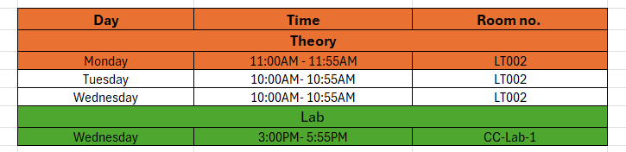
Class Schedule

Slide 5
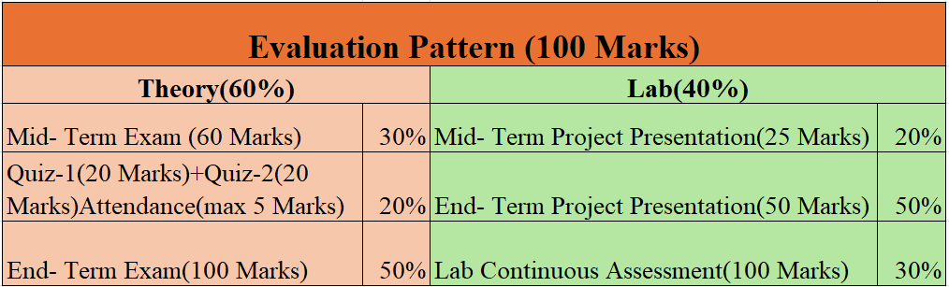

Evaluation Pattern

Slide 6
Artificial Intelligence
Data Science
Machine Learning
Deep Learning
Data Analytics

Slide 7
Definitions
Artificial Intelligence
“The study of [intelligent] agents that receive precepts from the environment and take action” ~ Russell and Norvig
Data Science
“Data science is the study of data to extract meaningful insights for business” ~ AWS
Machine learning
“Machine learning is the ability to solve a problem without being explicitly programmed” ~Arthur Samuel
Deep Learning
“Deep learning is a form of machine learning that enables computers to learn from experience and understand the world in terms of a hierarchy of concepts” ~ Ian Goodfellow
Data Analytics
“Data analysis is the process of inspecting, cleansing, transforming, and modeling data with the goal of discovering useful information, informing conclusions, and supporting decision-making.” ~ Meta S. Brown

Slide 8
Artificial Intelligence
Definition: Artificial Intelligence (AI) is the branch of computer science that aims to
create machines that can simulate human intelligence, such as thinking,
learning, and problem-solving.
Goal: The primary goal of AI is to develop systems that can perform tasks
intelligently—such as decision-making, visual perception, speech recognition,
and language translation.
Key Areas: AI includes fields like Machine Learning, Natural Language Processing (NLP),
Computer Vision, Robotics, and Expert Systems.
Real-World Applications: AI powers technologies like voice assistants (Siri, Alexa), self-driving cars,
facial recognition, recommendation systems, and chatbots.

Slide 9
Data Science
Definition: Data Science is an interdisciplinary field that combines statistics, programming, and domain knowledge to extract meaningful insights from data.
Core Components: It involves data collection, cleaning, analysis, modeling, and visualization to understand and solve real-world problems.
Tools & Techniques: Common tools include Python, R, SQL, Jupyter, Tableau, and techniques like machine learning, data mining, and statistical analysis.
Applications: Data Science is used in healthcare (disease prediction), finance (fraud detection), marketing (customer segmentation), and sports analytics.

Slide 10
Machine Learning
Definition: Machine Learning is a subset of Artificial Intelligence that enables systems
to learn from data and improve performance on tasks without being explicitly programmed.
Types of Learning: ML is categorized into Supervised, Unsupervised, and Reinforcement Learning,depending on the nature of the data and feedback.
Model Training: ML involves building models that identify patterns in historical data to make predictions or classifications on new, unseen data.
Applications: It is widely used in spam detection, recommendation systems,
stock market prediction, image classification, and language translation.

Slide 11
Deep Learning
Definition: Deep Learning is a subset of Machine Learning that uses artificial neural networks
with multiple layers to model complex patterns in data.
Neural Network Structure: A deep learning model is composed of an input layer, multiple hidden layers,
and an output layer, enabling it to learn hierarchical representations.
Learning Mechanism: Deep learning models learn by adjusting weights through a process
called backpropagation, guided by a loss function and an optimization
algorithm like gradient descent.
Data Dependency: Deep learning requires large amounts of labeled data and
high computational resources to effectively train deep architectures
and achieve high accuracy.

Slide 12
Data Analytics
Definition: Data Analytics is the systematic process of examining and interpreting data
to extract meaningful insights, patterns, and trends for informed decision-making.
Purpose-Oriented: The primary goal of data analytics is to convert raw data into actionable
knowledge that can guide business or research strategies.
Multi-Step Process: It involves a sequence of steps including data collection, cleaning, analysis,
modeling, and interpretation, often supported
by statistical and computational tools.
Insight Generation: Data Analytics enables organizations to understand past behavior (descriptive), determine causes (diagnostic), predict future outcomes (predictive), and suggest actions (prescriptive).

Slide 13
AI vs DS vs ML vs DL vs DA – Comparison Table
Aspect | Artificial Intelligence (AI) | Data Science (DS) | Machine Learning (ML) | Deep Learning (DL) | Data Analytics (DA)
Definition | Simulation of human intelligence in machines | Extracting knowledge and insights from data | Subset of AI: systems learn from data without explicit coding | Subset of ML using deep neural networks for feature learning | Analysis of data to discover trends and support decisions
Scope | Broadest – includes ML, DL, NLP, robotics | Broad – includes ML, DA, visualization, statistics | Narrower – a part of AI focused on learning from data | Narrow – focused on layered neural networks | Focused – mostly on descriptive and diagnostic insights
Goal | Build intelligent systems that mimic human thinking | Generate actionable insights and predictive models | Predict outcomes based on data | Automatically learn features and representations from data | Understand and summarize past data
Techniques Used | Planning, reasoning, ML, NLP, robotics | ML, statistics, big data, visualization | Regression, classification, clustering | CNN, RNN, GAN, Transformer, autoencoders | Descriptive & predictive stats, dashboards
Output | Intelligent agents or systems | Predictive models, insights, visualizations | Trained models that make decisions or predictions | High-performing models on complex tasks (vision, NLP, etc.) | Charts, reports, KPIs, trends
Data Dependency | Moderate to High | Very High – data is the core | High – needs large datasets for good accuracy | Very High – requires massive labeled datasets | Moderate – typically structured data
Example Tools | OpenAI, IBM Watson, ROS | Python, R, Jupyter, Hadoop, Tableau | Scikit-learn, PyTorch, XGBoost | TensorFlow, Keras, PyTorch | Excel, Power BI, SQL, Tableau
Applications | Chatbots, robotics, self-driving cars | Fraud detection, marketing, finance, healthcare analytics | Spam filtering, recommendation engines | Image recognition, speech synthesis, NLP models like GPT | Sales forecasting, business intelligence, trend analysis

Slide 14
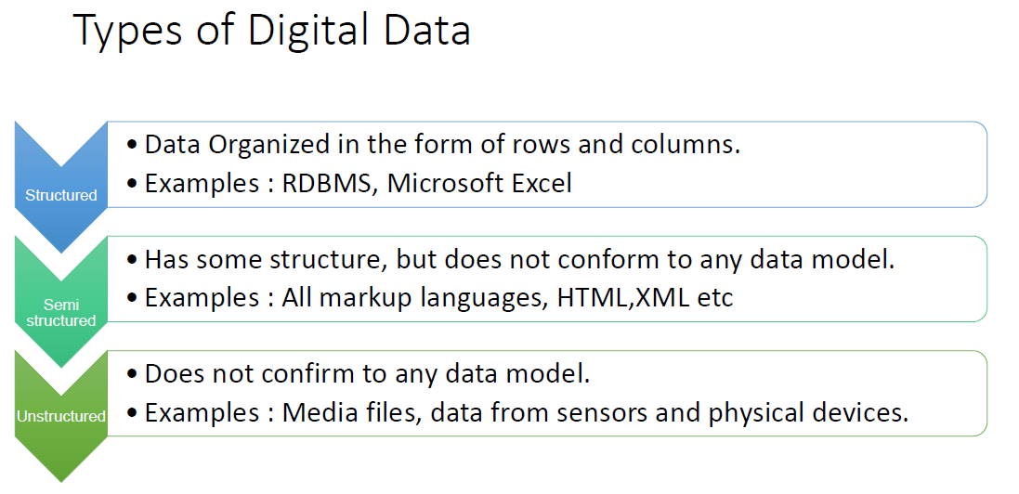

Slide 15
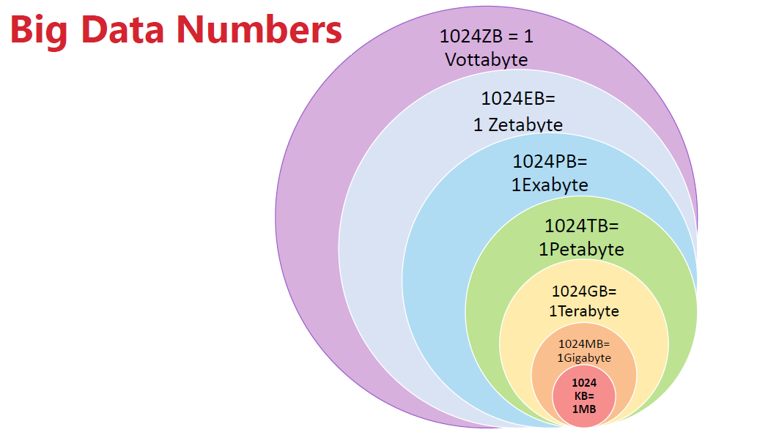

Slide 16
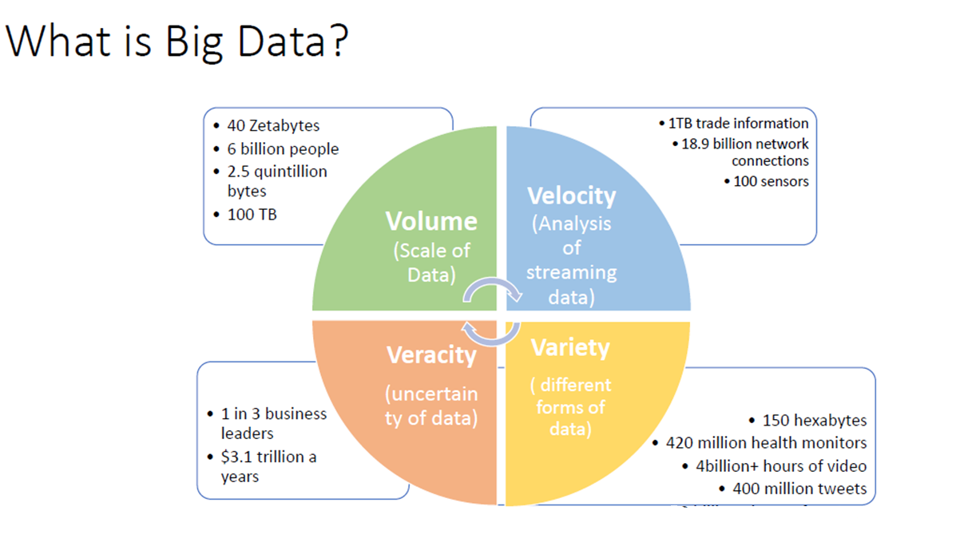

Slide 17
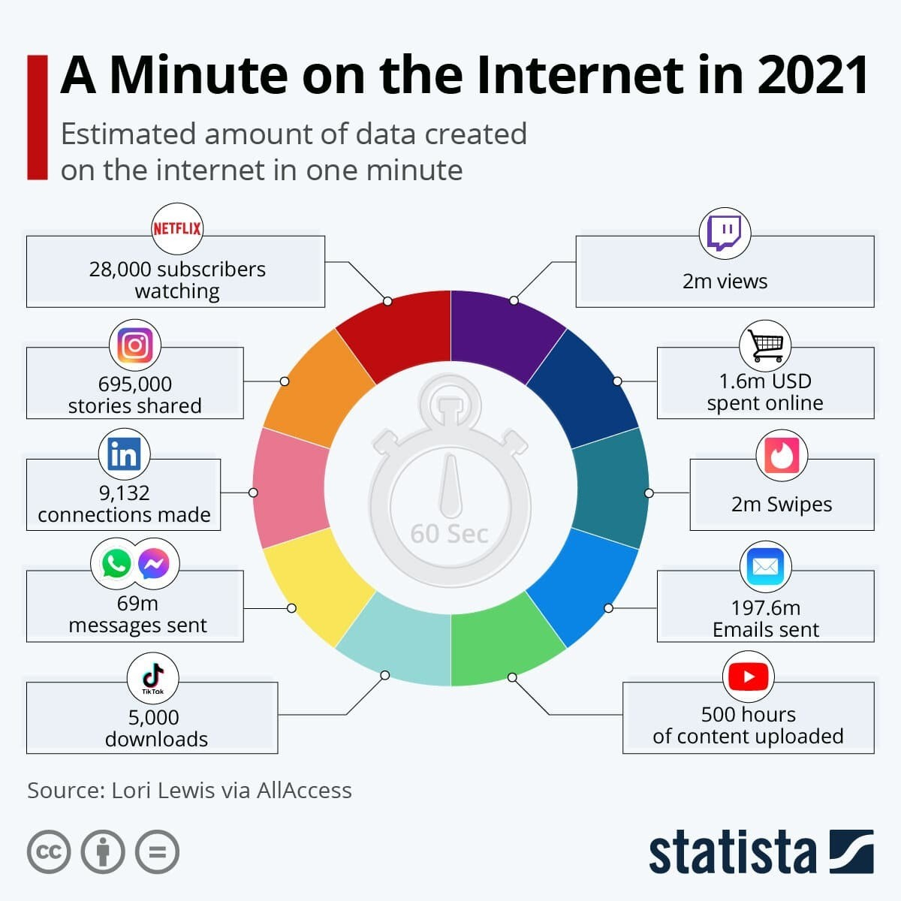
What Happens in 60 seconds over internet in 2023?
Link: https://www.weforum.org/agenda/2021/08/one-minute-internet-web-social-media-technology-online/

Slide 18
Machine Learning
“Learning is any process by which a system improves performance from experience.”
- Herbert Simon
Definition by Tom Mitchell (1998):
Machine Learning is the study of algorithms that
improve their performance P
at some task T
with experience E.
A well-defined learning task is given by <P, T, E>.

Slide 19
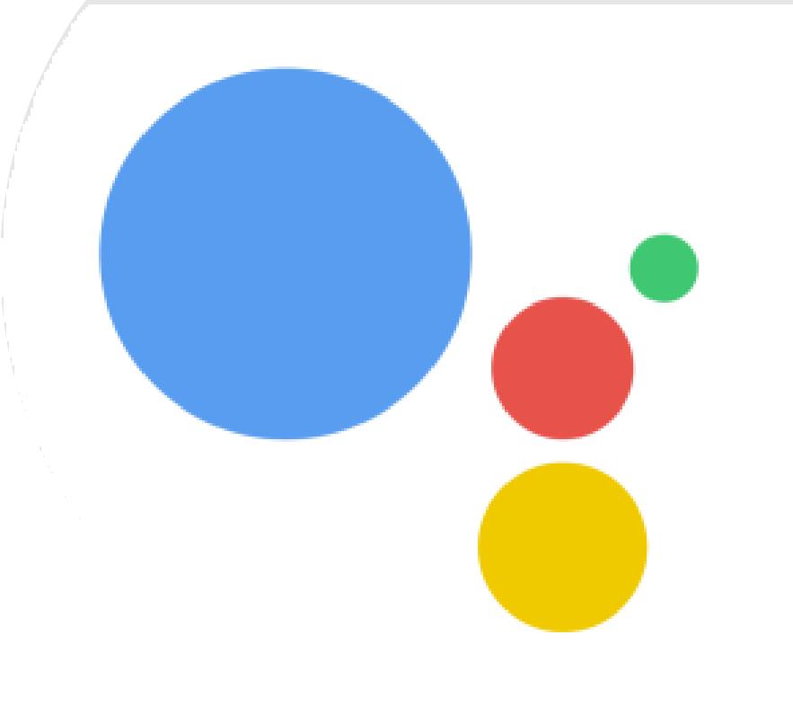
OK GOOGLE …WHAT IS
MACHINE LEARNING?
Machine learning (ML) is the scientific study of algorithms and statistical models that computer systems use to effectively perform a specific task without using explicit instructions, relying on models and inference instead.

Slide 20
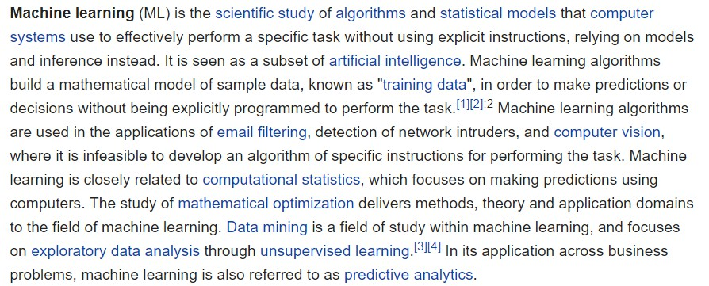
WHAT REALLY IS MACHINE LEARNING ?- WIKIPEDIA

Slide 21

IN SIMPLE TERMS ..
Using historical data to make future
predictions
Building models on historical data to predictions
Taking training data, building models on the training data using the models to make the future predictions
Making the machine learn the patterns
in the data

Slide 22
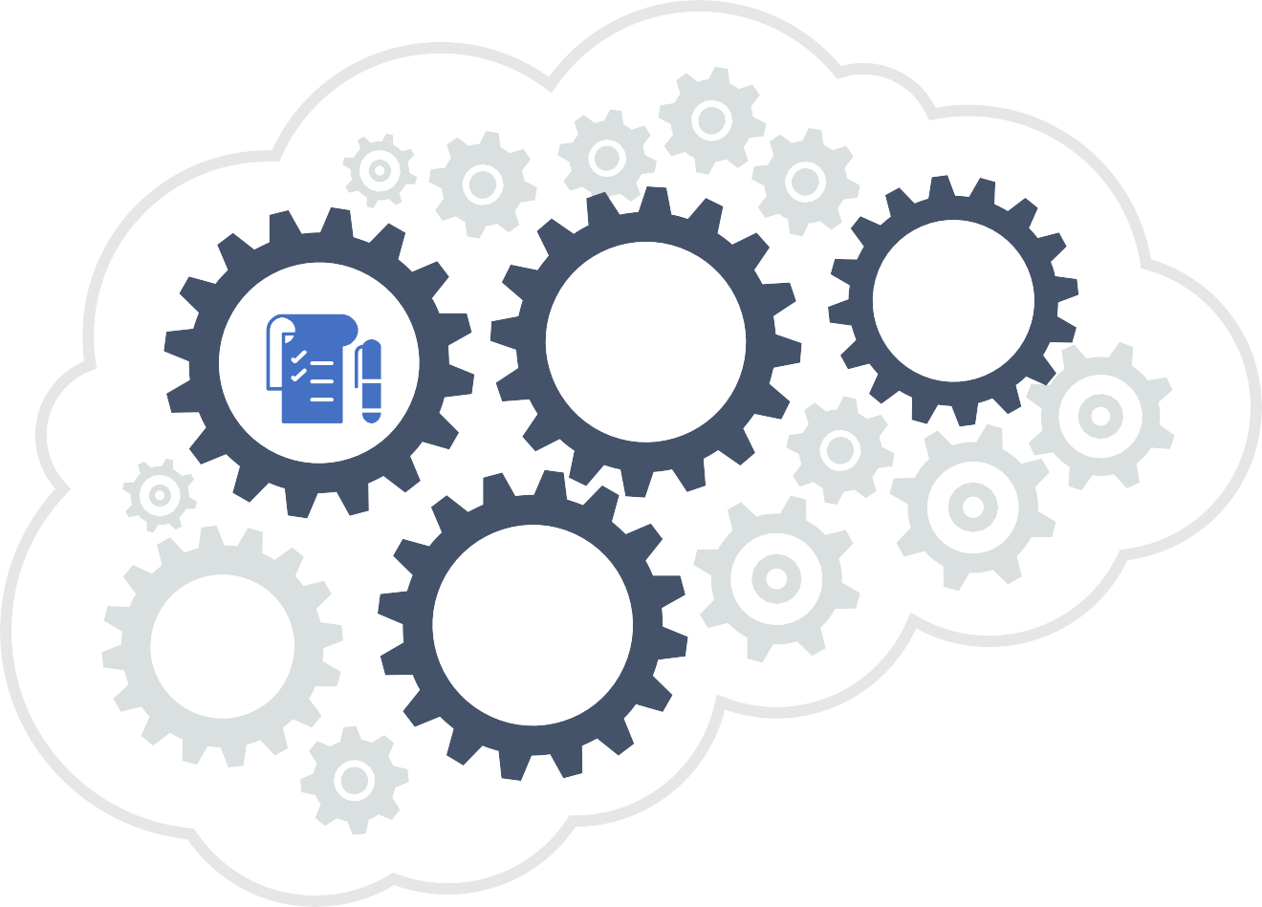




DATA IS IN DIFFERENT FORMS
Numerical data
Image data (pixel intensities) Video data (frames per second) Sound data (waves)
Text data (tweets, comments, feedback)

Slide 23





APPLICATIONS OF NUMERICAL DATA
CREDIT RISK MODELS
Identifying risky customers
before offering a loan
MARKETING ANALYTICS
Do you receive any marketing calls? Have you ever received any marketing call for Audi car?
RETAIL SALES ANALYTICS
Have you ever wondered, why only you are getting promotional offers on cloths and accessories where as I am getting offers on apartments?
FRAUD ANALYTICS
How does a bank decide the potential fraud transactions from millions of credit card swipes?

Slide 24
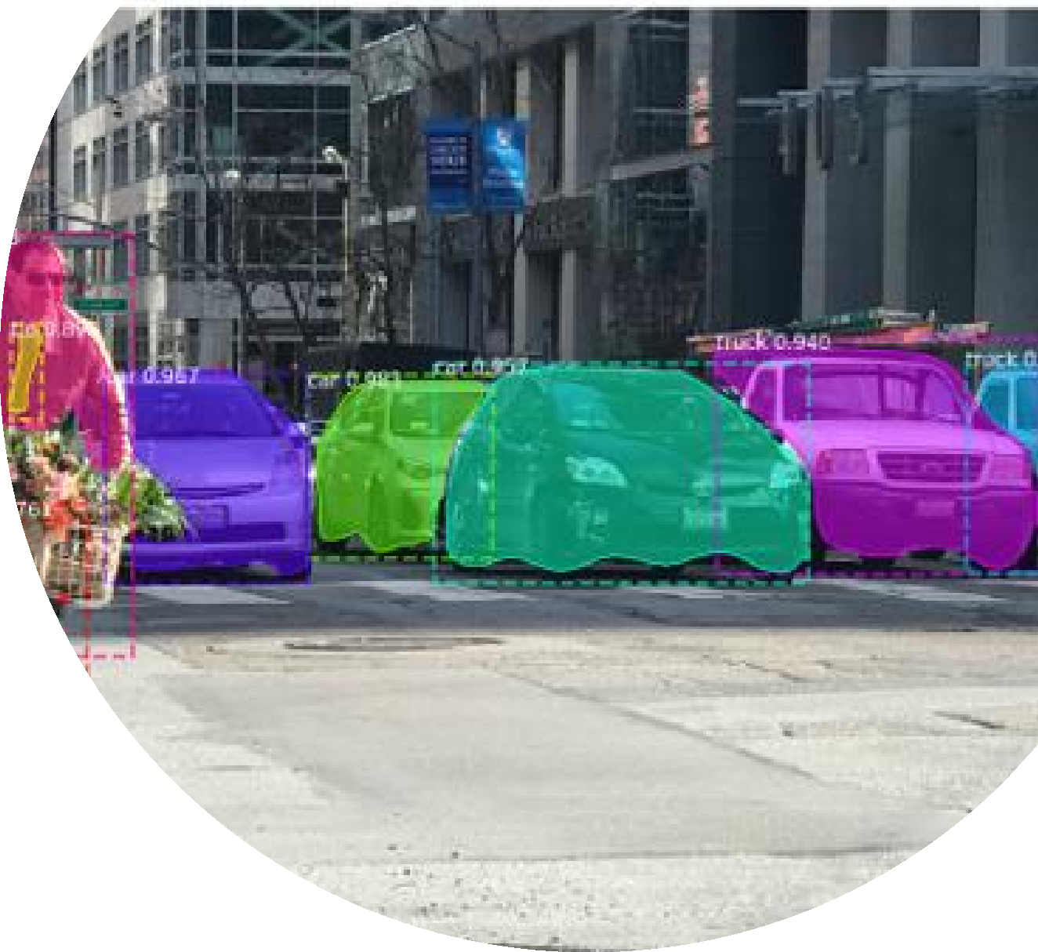
APPLICATIONS OF MACHINE LEARNING – IMAGES AND VIDEO DATA
Face recognition – Using image as input data
Object recognition – Pixels is the input data
Digit recognition – Using text as image
Self Driving Cars – Using video data as input

Slide 25

IMAGE DATA IS ALSO NUMERICAL DATA
Image data
-1 -1 -1 -1 -1 -1 -1 -1 0.9 -0 -1 -1 -1 -1 -1 -1
-1 -1 -1 -1 -1 -1 -1 0.3 1 0.3 -1 -1 -1 -1 -1 -1
-1 -1 -1 -1 -1 -1 -0 1 1 -1 -1 -1 -1 -1 -1 -1
-1 -1 -1 -1 -1 -1 0.8 1 0.6 -1 -1 -1 -1 -1 -1 -1
-1 -1 -1 -1 -1 0.5 1 0.8 -1 -1 -1 -1 -1 -1 -1 -1
-1 -1 -1 -1 0.1 1 0.9 -0 -1 -1 -1 -1 -1 -1 -1 -1
-1 -1 -1 -0 1 1 -0 -1 -1 -1 -1 -1 -1 -1 -1 -1
-1 -1 -1 0.9 1 0.3 -1 -1 -1 -1 0.5 1 0.9 0.1 -1 -1
-1 -1 0.3 1 0.9 -1 -1 -1 0.1 1 1 1 1 1 -1 -1
-1 -1 0.8 1 0.3 -1 -1 0.4 1 0.7 -0 -0 1 1 -1 -1
-1 -1 1 1 0.1 -1 0.1 1 0.3 -1 -1 -0 1 0.6 -1 -1
-1 -1 1 1 0.8 0.3 1 0.7 -1 -1 -1 0.5 1 0 -1 -1
-1 -1 0.8 1 1 1 1 0.5 0.2 0.8 0.8 1 0.9 -1 -1 -1
-1 -1 -0 0.8 1 1 1 1 1 1 1 1 0.1 -1 -1 -1
-1 -1 -1 -0 0.8 1 1 1 1 1 1 0.2 -1 -1 -1 -1
-1 -1 -1 -1 -1 -0 0.3 0.8 1 0.5 -0 -1 -1 -1 -1 -1
Human Vision
Computer Vision
Statinfer.com
3

Slide 26
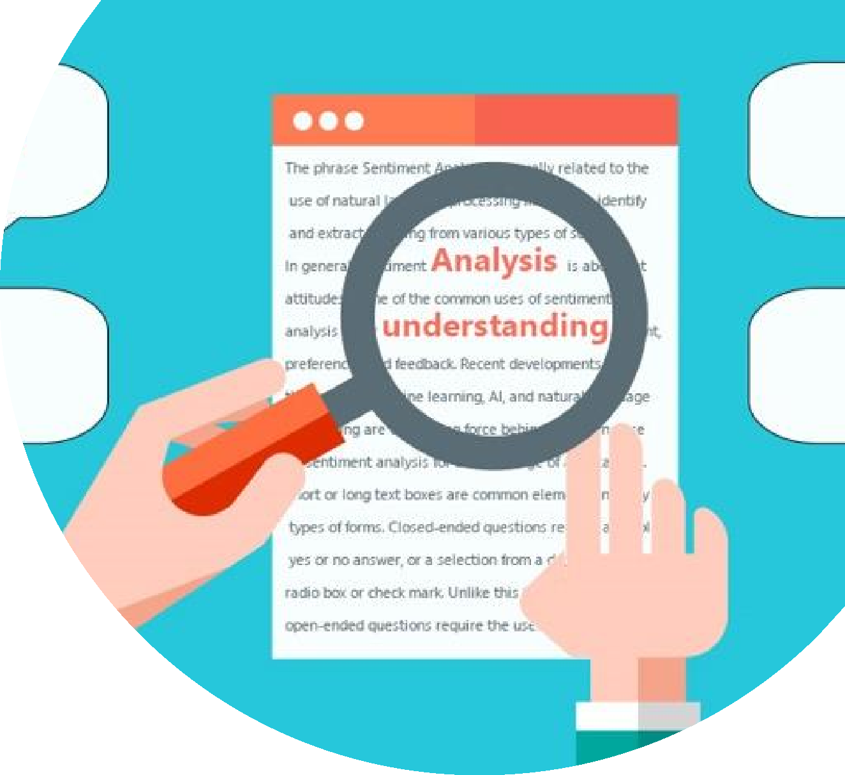
APPLICATIONS ON TEXT DATA
Sentiment Analysis
Extraction of key topics in the data
Document Classification

Slide 27
Traditional Programming
Data Program
Computer
Output
Machine Learning
Data Output
Computer
Program
Slide credit: Pedro Domingos

Slide 28

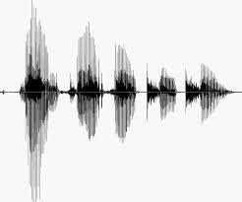
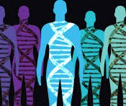
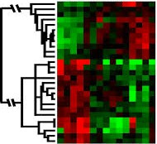
When Do We Use Machine Learning?
ML is used when:
Human expertise does not exist (navigating on Mars)
Humans can’t explain their expertise (speech recognition)
Models must be customized (personalized medicine)
Models are based on huge amounts of data (genomics)
Learning isn’t always useful:
There is no need to “learn” to calculate payroll
Based on slide by E. Alpaydin

Slide 29
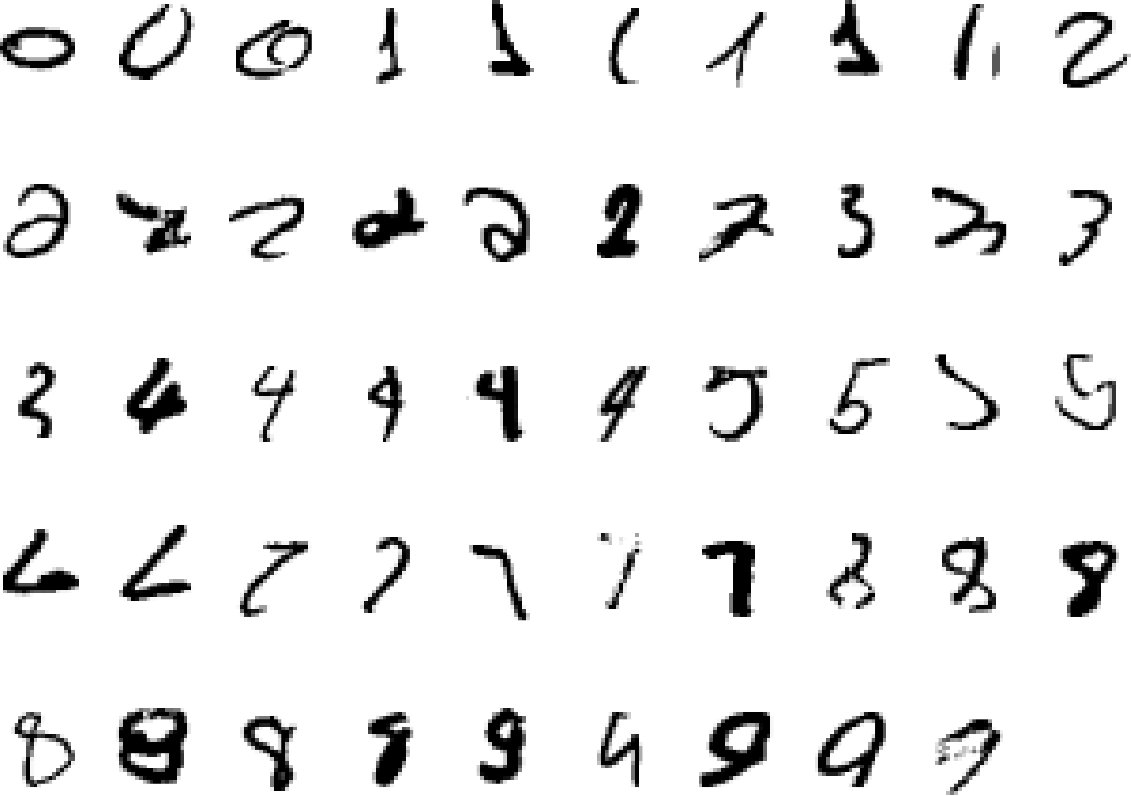
A classic example of a task that requires machine learning: It is very hard to say what makes a 2
Slide credit: Geoffrey Hinton

Slide 30
Some more examples of tasks that are best solved by using a learning algorithm
Recognizing patterns:
Facial identities or facial expressions
Handwritten or spoken words
Medical images
Generating patterns:
Generating images or motion sequences
Recognizing anomalies:
Unusual credit card transactions
Unusual patterns of sensor readings in a nuclear power plant
Prediction:
Future stock prices or currency exchange rates
Slide credit: Geoffrey Hinton

Slide 31
Sample Applications
Web search
Computational biology
Finance
E-commerce
Space exploration
Robotics
Information extraction
Social networks
Debugging software
Slide credit: Pedro Domingos

Slide 32
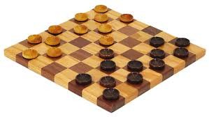
Samuel’s Checkers-Player
“Machine Learning: Field of study that gives computers the ability to learn without being explicitly programmed.” -Arthur Samuel (1959)

Slide 33
Defining the Learning Task
Improve on task T, with respect to performance metric P, based on experience E
T: Playing checkers
P: Percentage of games won against an arbitrary opponent E: Playing practice games against itself
T: Recognizing hand-written words
P: Percentage of words correctly classified
E: Database of human-labeled images of handwritten words
T: Driving on four-lane highways using vision sensors
P: Average distance traveled before a human-judged error
E: A sequence of images and steering commands recorded while observing a human driver.
T: Categorize email messages as spam or legitimate. P: Percentage of email messages correctly classified. E: Database of emails, some with human-given labels
Slide credit: Ray Mooney

Slide 34
State of the Art Applications of Machine Learning

Slide 35
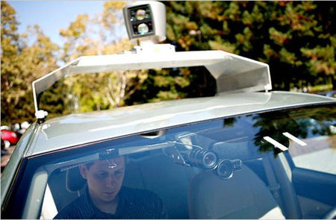
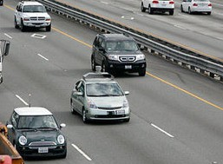
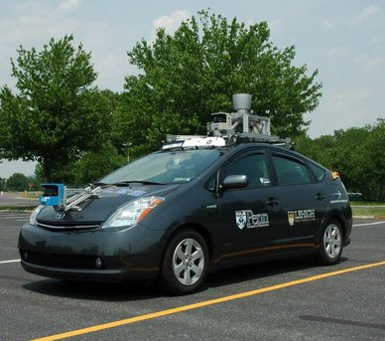
Autonomous Cars
Nevada made it legal for autonomous cars to drive on roads in June 2011
As of 2013, four states (Nevada, Florida, California, and Michigan) have legalized autonomous cars
Penn’s Autonomous Car →
(Ben Franklin Racing Team)

Slide 36
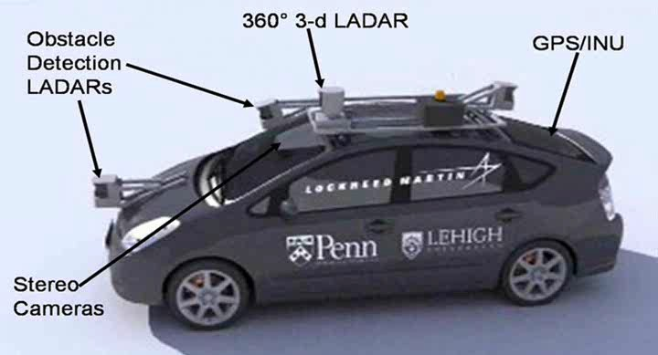
Autonomous Car Sensors
13

Slide 37
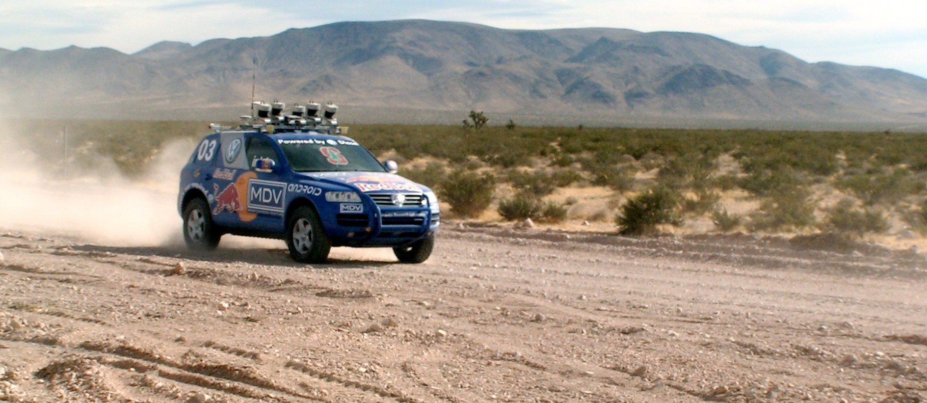
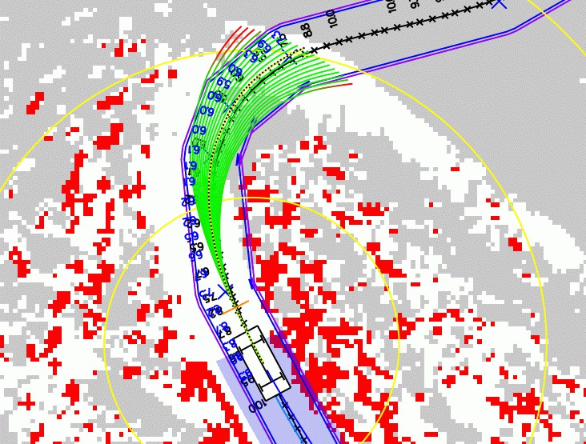
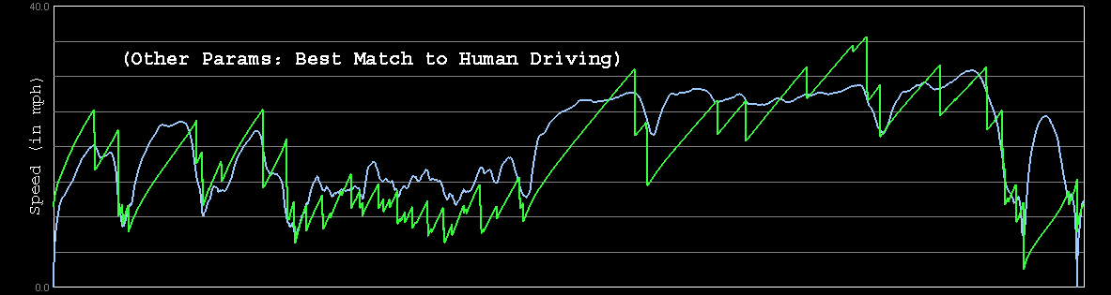

Autonomous Car Technology
Path Planning
Laser Terrain Mapping
Learning from Human Drivers
Sebastian
Adaptive Vision
Stanley
Images and movies taken from Sebastian Thrun’s multimedia website.

Slide 38


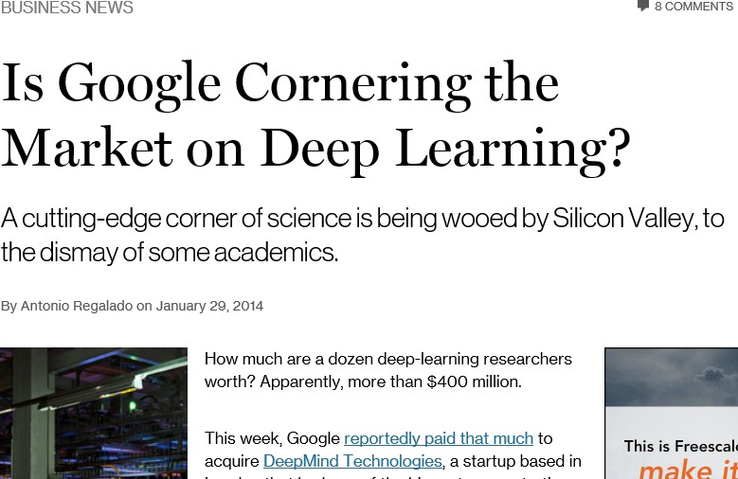
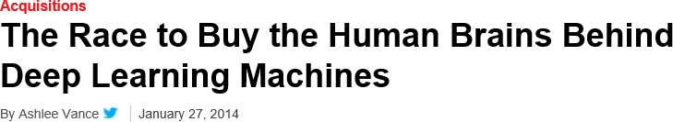
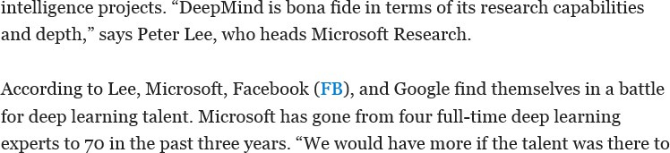
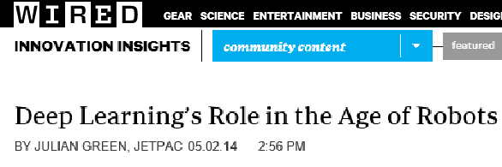
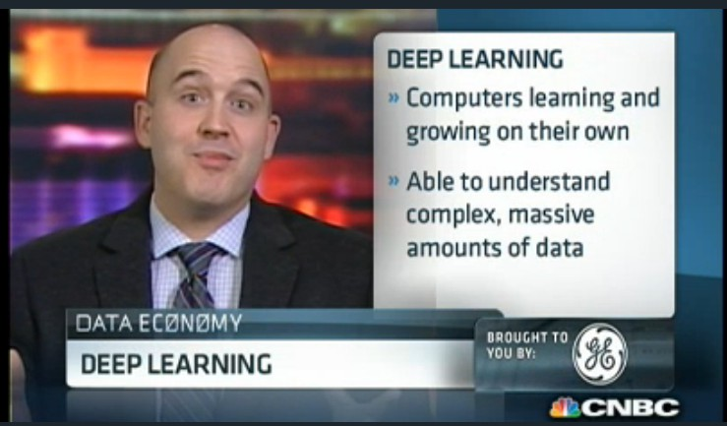
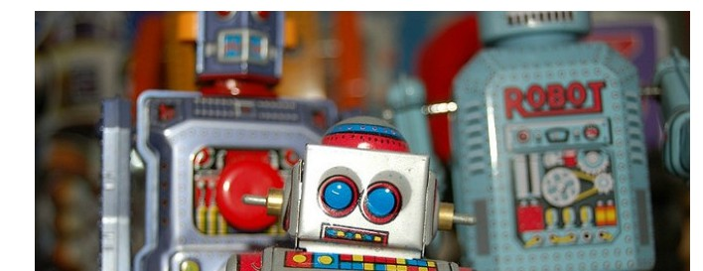
Deep Learning in the Headlines
15

Slide 39
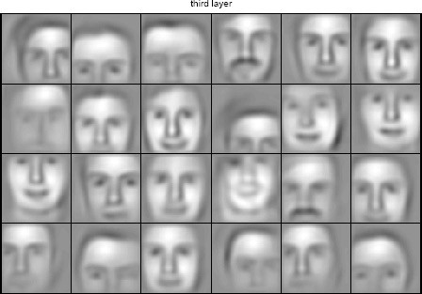
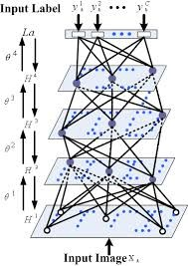

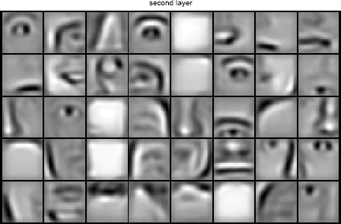


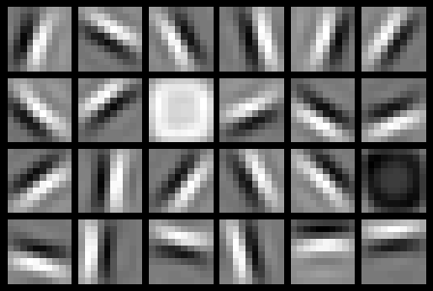




Deep Belief Net on Face Images
object models
object parts (combination of edges)
edges
pixels
Based on materials by Andrew Ng

Slide 40
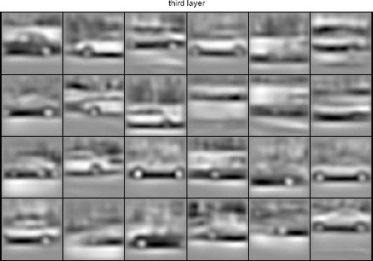
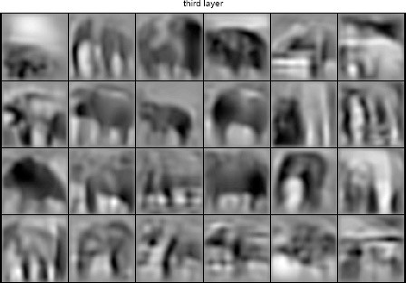
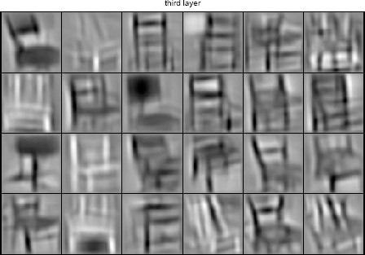
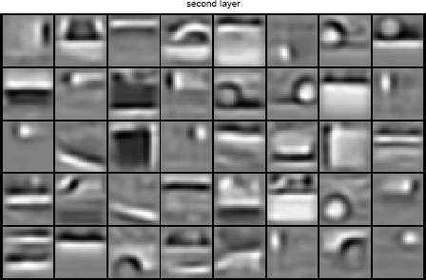
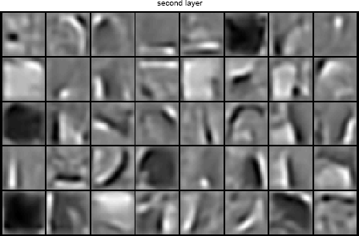
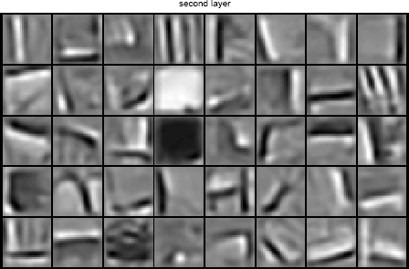
Learning of Object Parts
Slide credit: Andrew Ng

Slide 41
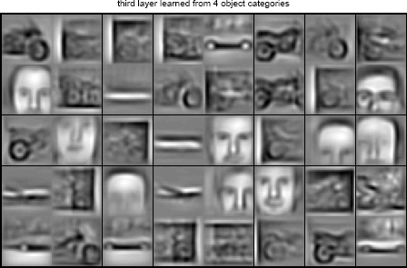
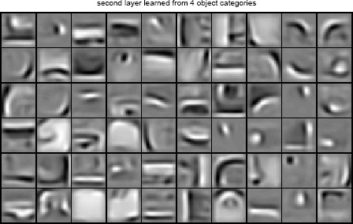
Training on Multiple Objects
Trained on 4 classes (cars, faces, motorbikes, airplanes).
Second layer: Shared-features and object-specific features.
Third layer: More specific features.
Slide credit: Andrew Ng

Slide 42
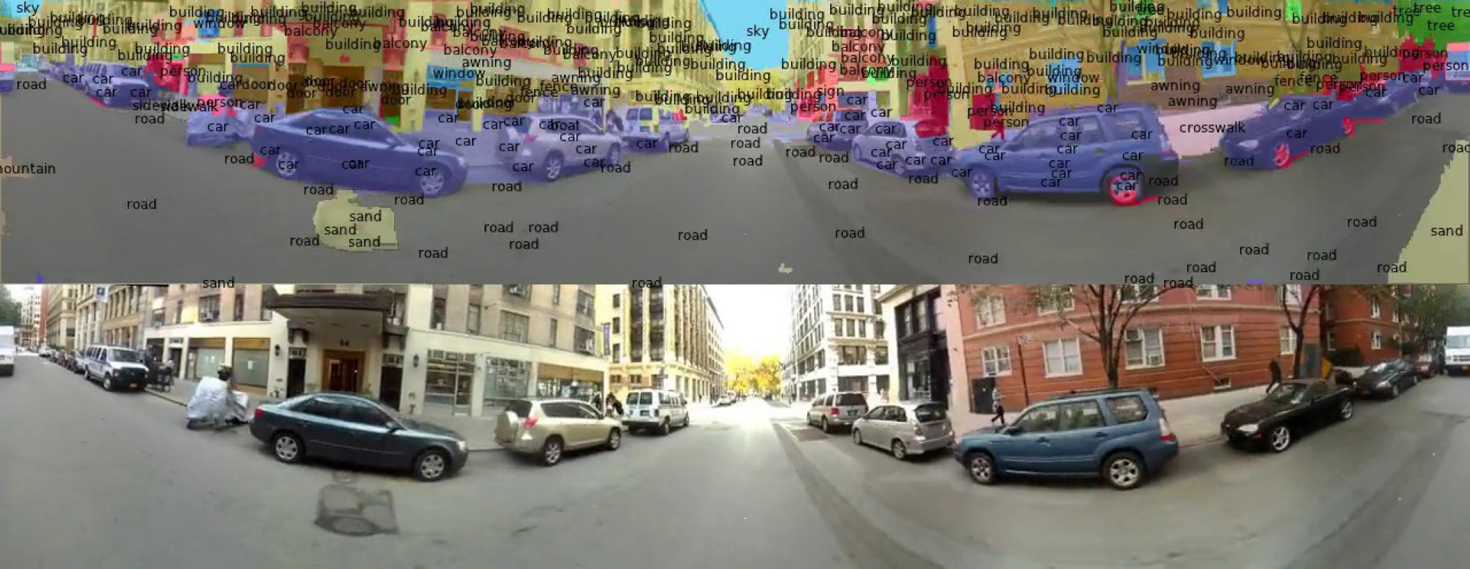
Scene Labeling via Deep Learning
[Farabet et al. ICML 2012, PAMI 2013]

Slide 43
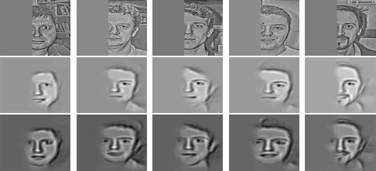
Inference from Deep Learned Models
Generating posterior samples from faces by “filling in” experiments
(cf. Lee and Mumford, 2003). Combine bottom-up and top-down inference.
Input images
Samples from feedforward Inference (control)
Samples from Full posterior inference
Slide credit: Andrew Ng

Slide 44
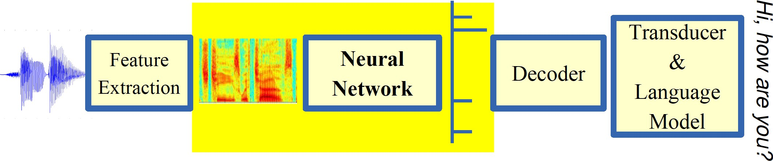
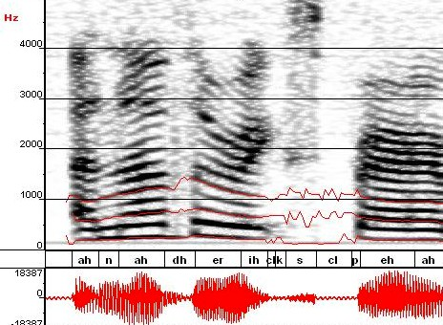
Machine Learning in Automatic Speech Recognition
A Typical Speech Recognition System
ML used to predict of phone states from the sound spectrogram
Deep learning has state-of-the-art results
# Hidden Layers | 1 | 2 | 4 | 8 | 10 | 12
Word Error Rate % | 16.0 | 12.8 | 11.4 | 10.9 | 11.0 | 11.1
Baseline GMM performance = 15.4%
[Zeiler et al. “On rectified linear units for speech recognition” ICASSP 2013]

Slide 45
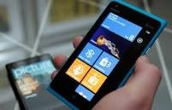
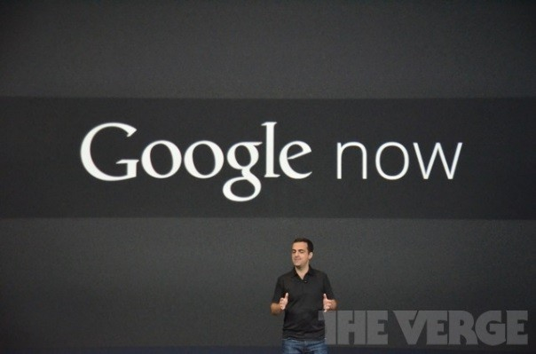

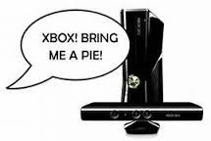



Impact of Deep Learning in Speech Technology
Slide credit: Li Deng, MS Research

Slide 46
Types of Learning

Slide 47
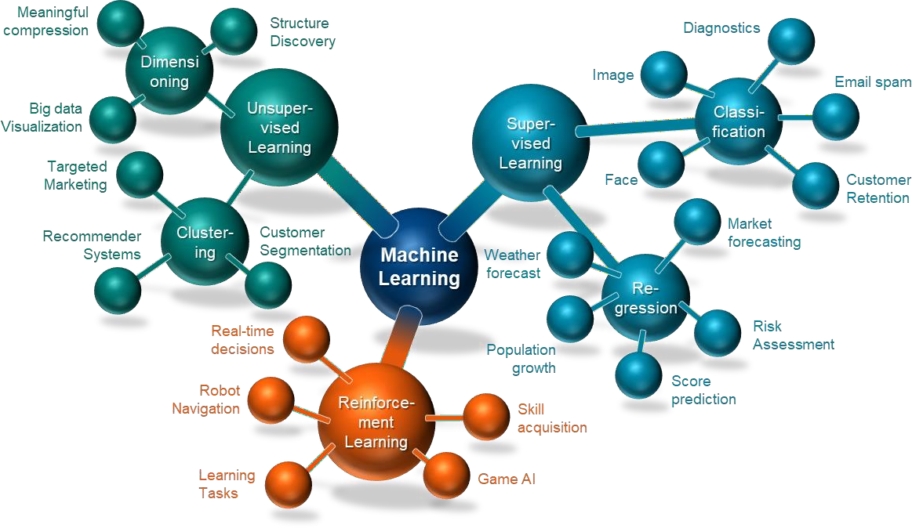
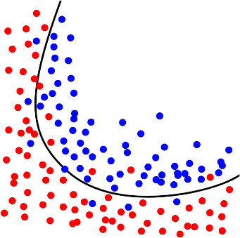



SUPERVISED – UNSUPERVISED – REINFORCEMENT
Training data
{labeled input, desired output}
To judge, which class the input data belongs too…
Training data
{unlabeled input only}
The model shall estimate
the trend of the data…
Training data
{input, some output, grade of output}

Slide 48
Types of Learning
Supervised (inductive) learning
Given: training data + desired outputs (labels)
Unsupervised learning
Given: training data (without desired outputs)
Semi-supervised learning
Given: training data + a few desired outputs
Reinforcement learning
Rewards from sequence of actions
Based on slide by Pedro Domingos

Slide 49



Supervised Learning: Regression
Given (x₁, y₁), (x₂, y₂), ..., (x_{n}, y_{n})
Learn a function f(x) to predict y given x
– y is real-valued == regression
9
8
7
6
5
4
3
2
1
0
1970 1980
September Arctic Sea Ice Extent (1,000,000 sq km)
1990 2000
2010
2020
Year
Data from G. Witt. Journal of Statistics Education, Volume 21, Number 1 (2013)

Slide 50










Supervised Learning: Classification
Given (x₁, y₁), (x₂, y₂), ..., (x_{n}, y_{n})
Learn a function f(x) to predict y given x
– y is categorical == classification
Breast Cancer (Malignant / Benign)
1(Malignant)
0(Benign)
Tumor Size
Based on example by Andrew Ng

Slide 51







Supervised Learning: Classification
Given (x₁, y₁), (x₂, y₂), ..., (x_{n}, y_{n})
Learn a function f(x) to predict y given x
– y is categorical == classification
Breast Cancer (Malignant / Benign)
1(Malignant)
0(Benign)
Tumor Size
Tumor Size
Based on example by Andrew Ng

Slide 52






Supervised Learning: Classification
Given (x₁, y₁), (x₂, y₂), ..., (x_{n}, y_{n})
Learn a function f(x) to predict y given x
– y is categorical == classification
Breast Cancer (Malignant / Benign)
1(Malignant)
0(Benign)
Tumor Size
Predict Benign Predict Malignant
Tumor Size
Based on example by Andrew Ng

Slide 53










Supervised Learning
x can be multi-dimensional
– Each dimension corresponds to an attribute
Clump Thickness
Uniformity of Cell Size
Uniformity of Cell Shape
…
Age
Tumor Size
Based on example by Andrew Ng

Slide 54
















Unsupervised Learning
Given x₁, x₂, ..., x_{n} (without labels)
Output hidden structure behind the x’s
– E.g., clustering
31

Slide 55

Unsupervised Learning
Genomics application: group individuals by genetic similarity
Genes
Individuals
[Source: Daphne Koller]

Slide 56












Unsupervised Learning
Organize computing clusters
Social network analysis
Market segmentation
Slide credit: Andrew Ng
Image credit: NASA/JPL-Caltech/E. Churchwell (Univ. of Wisconsin, Madison)
Astronomical data analysis

Slide 57



Unsupervised Learning
Independent component analysis – separate a combined signal into its original sources
Image credit: statsoft.com Audio from http://www.ism.ac.jp/~shiro/research/blindsep.html

Slide 58
Unsupervised Learning
Independent component analysis – separate a combined signal into its original sources
Image credit: statsoft.com Audio from http://www.ism.ac.jp/~shiro/research/blindsep.html

Slide 59



MACHINE LEARNING BASED ON NEURAL NETWORKS (NN)
Input layer
Hidden layer
Hidden layer
Output layer
[N, 4]
[4, 7]
[7, 5]
[5, 3]

Slide 60






MACHINE LEARNING BASED ON NEURAL NETWORKS (NN)
a1) Recurrent Neural Network (RNN)
a2) Convolutional Neural b) Concept of an Autoencoder Network (CNN)
Recurrent Neural Network
(RNN) are a type of Neural Network where the output from previous step are fed as input to the current step
Useful, in time series prediction (“memory”)
Source: geeksforgeeks.org, analyticsindiamag.com
A convolutional neural
network is a feed-forward neural network, often with up to 30 (hidden) layers, designed for processing structured arrays of data such as images
Source: deepai.org, analyticsvidhya.com
Special type of artificial
neural network to learn efficient data coding in an unsupervised manner
Autoencoder learns a representation for data set, by training the network to ignore insignificant data
Source: wikipedia.org, towardsdatascience.com
June 2022 The future role of AI/ML in wireless communication

Slide 61
Reinforcement Learning
Given a sequence of states and actions with (delayed) rewards, output a policy
Policy is a mapping from states → actions that tells you what to do in a given state
Examples:
Credit assignment problem
Game playing
Robot in a maze
Balance a pole on your hand

Slide 62

The Agent-Environment Interface
Agent and environment interact at discrete time steps Agent observes state at step t : s_{t} ∈S
: t = 0, 1, 2, K
produces action at step t : a_{t} ∈ A(s_{t} )
gets resulting reward : and resulting next state :
r_{t +1} ∈ℜ
^{s}t +1
. . .
^{r}t +1 _{st +1}
^{r}t +2 _{st +2}
^{r}t +3
. . .
s
t
a_{t}
^{s}t +3
ªt +1
ªt +2
ªt +3
Slide credit: Sutton & Barto

Slide 63

Reinforcement Learning
https://www.youtube.com/watch?v=4cgWya-wjgY

Slide 64


Inverse Reinforcement Learning
Learn policy from user demonstrations
Stanford Autonomous Helicopter http://heli.stanford.edu/ https://www.youtube.com/watch?v=VCdxqn0fcnE

Slide 65
Framing a Learning Problem

Slide 66






Designing a Learning System
Choose the training experience
Choose exactly what is to be learned
– i.e. the target function
Choose how to represent the target function
Choose a learning algorithm to infer the target function from the experience
Training data
Learner
Environment/ Experience
Knowledge
Testing data
Performance Element
Based on slide by Ray Mooney

Slide 67
Training vs. Test Distribution
We generally assume that the training and test examples are independently drawn from the same overall distribution of data
– We call this “i.i.d” which stands for “independent and identically distributed”
If examples are not independent, requires
collective classification
If test distribution is different, requires
transfer learning
Slide credit: Ray Mooney

Slide 68
ML in a Nutshell
Tens of thousands of machine learning algorithms
Hundreds new every year
Every ML algorithm has three components:
Representation
Optimization
Evaluation
Slide credit: Pedro Domingos

Slide 69
Various Function Representations
Numerical functions
Linear regression
Neural networks
Support vector machines
Symbolic functions
Decision trees
Rules in propositional logic
Rules in first-order predicate logic
Instance-based functions
Nearest-neighbor
Case-based
Probabilistic Graphical Models
Naïve Bayes
Bayesian networks
Hidden-Markov Models (HMMs)
Probabilistic Context Free Grammars (PCFGs)
Markov networks
Slide credit: Ray Mooney

Slide 70
Various Search/Optimization Algorithms
Gradient descent
Perceptron
Backpropagation
Dynamic Programming
HMM Learning
PCFG Learning
Divide and Conquer
Decision tree induction
Rule learning
Evolutionary Computation
Genetic Algorithms (GAs)
Genetic Programming (GP)
Neuro-evolution
Slide credit: Ray Mooney

Slide 71
Evaluation
Accuracy
Precision and recall
Squared error
Likelihood
Posterior probability
Cost / Utility
Margin
Entropy
K-L divergence
etc.
Slide credit: Pedro Domingos

Slide 72


ML in Practice
Understand domain, prior knowledge, and goals
Data integration, selection, cleaning, pre-processing, etc.
Learn models
Interpret results
Consolidate and deploy discovered knowledge
Loop
Based on a slide by Pedro Domingos

Slide 73
Lessons Learned about Learning
Learning can be viewed as using direct or indirect experience to approximate a chosen target function.
Function approximation can be viewed as a search through a space of hypotheses (representations of functions) for one that best fits a set of training data.
Different learning methods assume different hypothesis spaces (representation languages) and/or employ different search techniques.
Slide credit: Ray Mooney

Slide 74
A Brief History of Machine Learning

Slide 75
History of Machine Learning
1950s
Samuel’s checker player
Selfridge’s Pandemonium
1960s:
Neural networks: Perceptron
Pattern recognition
Learning in the limit theory
Minsky and Papert prove limitations of Perceptron
1970s:
Symbolic concept induction
Winston’s arch learner
Expert systems and the knowledge acquisition bottleneck
Quinlan’s ID3
Michalski’s AQ and soybean diagnosis
Scientific discovery with BACON
Mathematical discovery with AM
Slide credit: Ray Mooney

Slide 76
History of Machine Learning (cont.)
1980s:
Advanced decision tree and rule learning
Explanation-based Learning (EBL)
Learning and planning and problem solving
Utility problem
Analogy
Cognitive architectures
Resurgence of neural networks (connectionism, backpropagation)
Valiant’s PAC Learning Theory
Focus on experimental methodology
1990s
Data mining
Adaptive software agents and web applications
Text learning
Reinforcement learning (RL)
Inductive Logic Programming (ILP)
Ensembles: Bagging, Boosting, and Stacking
Bayes Net learning
Slide credit: Ray Mooney

Slide 77
History of Machine Learning (cont.)
2000s
Support vector machines & kernel methods
Graphical models
Statistical relational learning
Transfer learning
Sequence labeling
Collective classification and structured outputs
Computer Systems Applications (Compilers, Debugging, Graphics, Security)
E-mail management
Personalized assistants that learn
Learning in robotics and vision
2010s
Deep learning systems
Learning for big data
Bayesian methods
Multi-task & lifelong learning
Applications to vision, speech, social networks, learning to read, etc.
Based on slide by Ray Mooney

Slide 78
What We’ll Cover in this Course
Supervised learning
Decision tree induction
Linear regression
Logistic regression
Support vector machines & kernel methods
Model ensembles
Bayesian learning
Neural networks & deep learning
Learning theory
Unsupervised learning
Different Clustering techniques
Dimensionality reduction
Ensembles Learning
Evaluation
Applications
Our focus will be on applying machine learning to real applications

